Slide 1

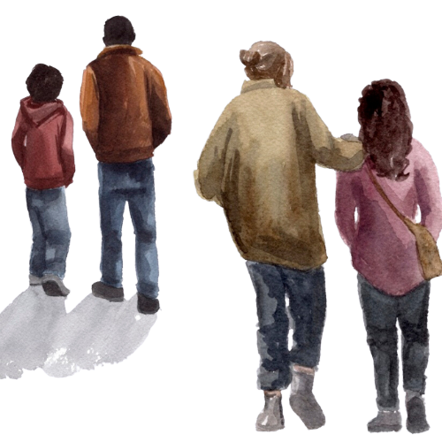
Empowering Direct
Care Staff to Build
Trauma-Informed
Communities
For Youth.

Slide 2

You’ll get a lot of training in your new role…
Safety and Emergency Interventions
Agency Policies, Practices, Protocols, and Paperwork
Trauma-Informed Programs to use with Youth
But EQ2 is for YOU!
Notes:
This slide helps differentiate EQ2 from the other trainings they receive. Highlighting that EQ2 is really for them.

Slide 3
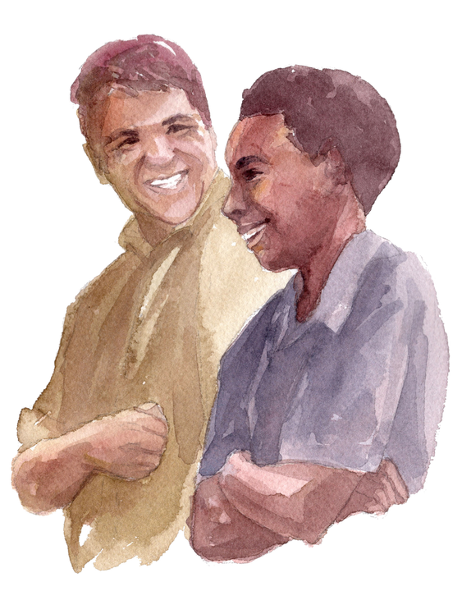


What is EQ2?
EQ2 is a training and support program for everyone working with trauma-impacted youth:
Provides easy-to-use practices that can help us deal with the stress of work… and life.
Increases our knowledge about how trauma impacts youth and how trauma can impact US.
Builds our Emotion Coaching Skills so we can keep ourselves calm and pass these skills onto youth.
Notes:
Take time to explain what the EQ2 program is.
Review each bullet point and highlight that EQ2 is program that:
* helps staff to manage stress, including secondary trauma and burnout, both at work and in their home lives
* helps staff to build self-regulation skills and teaches them how to co-regulate with youth
* teaches staff to understand what triggers them and manage the dysregulation that might come up as a result of those triggers
* teaches staff how to build effective and reparative relationship with the youth they are serving

Slide 4
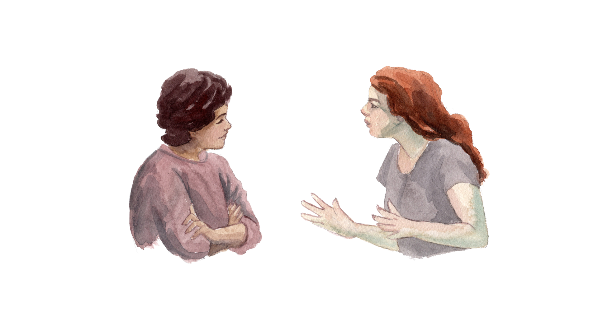
What is EQ?
EQ stands for Emotional Intelligence:
Being able to understand and manage your emotions in a good way
Understanding the emotions of youth (and other staff) and teaching youth to manage their emotions effectively
EQ2 =
Youth EQ
+
Staff EQ
Notes:
Briefly explain EQ = Emotional Intelligence. EQ has been shown to predict success at work and school better than IQ (intellectual intelligence).
The the acronym EQ2 means the combined emotional intelligence (EQ2) of staff and youth. Youth EQ2 + Staff EQ2 = EQ2.

Slide 5

An EQ2 Core Belief…
There is no more important (or challenging) work on the planet. Direct care staff have the power to impact a child’s life in deep, positive, and lasting ways.
Notes:
Broadly speaking, this slide helps staff to begin to frame their roles as “Emotion Coaches” as we do in EQ2. If you haven’t already, you might share more information about the types of youth you serve (e.g., X amount have ACEs of 5 or higher… etc.) and the experiences they’ve been through.
Review the first EQ2 core belief. Prompt staff to reflect on their reactions to this.
You might also encourage staff to reflect on how they currently see their role in relation to helping youth recover from the impacts of trauma or hardship.
If appropriate/helpful for your group, trainer can share an anecdote of a way that a youth’s life was impacted by a staff member in a positive way. Many people connect more to stories than to theory, and stories that come directly from your unique agency with the youth you serve often land better.

Slide 6
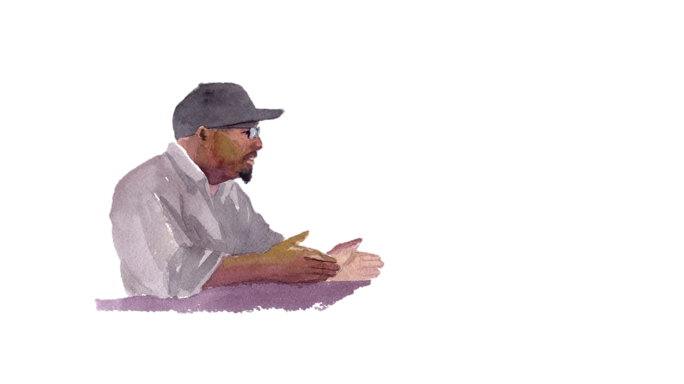
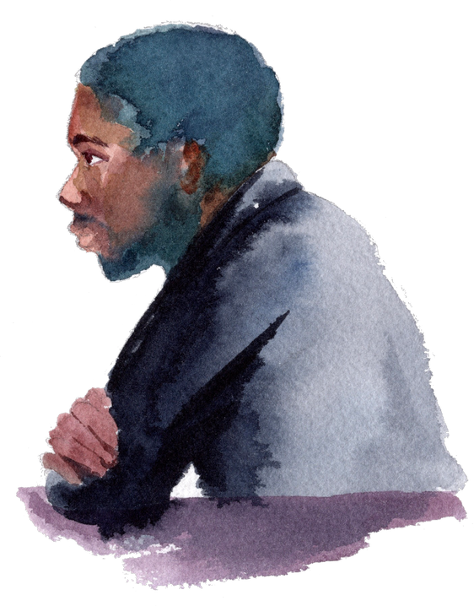
So, How We Show Up Matters!
Every interaction we have with youth has the potential to hurt or heal.
Each exchange sends a message of whether people…
…are trustworthy or not.
…are safe or not.
…are reliable or not.
Notes:
Highlight the truth that how we show up as direct care staff can have a profound impact on youth.
For trainers: you might encourage staff to think about why it’s important for youth to view us as trustworthy, safe, or reliable. What happens if they don’t view us that way?

Slide 7
Another EQ2 Core Belief:
Emotions Are Contagious
“I woke up agitated. I came to work agitated. And it wasn’t long before the whole d@^# place was agitated.”
Anthony, Direct Care Staff
Notes:
Review the second EQ2 core belief, that emotions are contagious. Not only do we bring how we are outside into work, but we can bring how we are at work back into our home lives.

Slide 8
If We Don’t Get Good at Managing Our Emotions, Our Emotions Wind Up Managing Us.
EQ2 helps us:
Know what we’re feeling (anger, fear, frustration) so we don’t get hijacked by our emotions.
Teach youth how to manage their emotions. Youth learn by watching us!
Manage our stress at work and at home.
Notes:
Read through slide. Highlight that EQ2 helps us get better at:
Knowing HOW we feel (self-awareness)
Doing something to shift how we feel (cool thoughts and good moves) so that we can show up for the youth in our care… and for our people at home

Slide 9

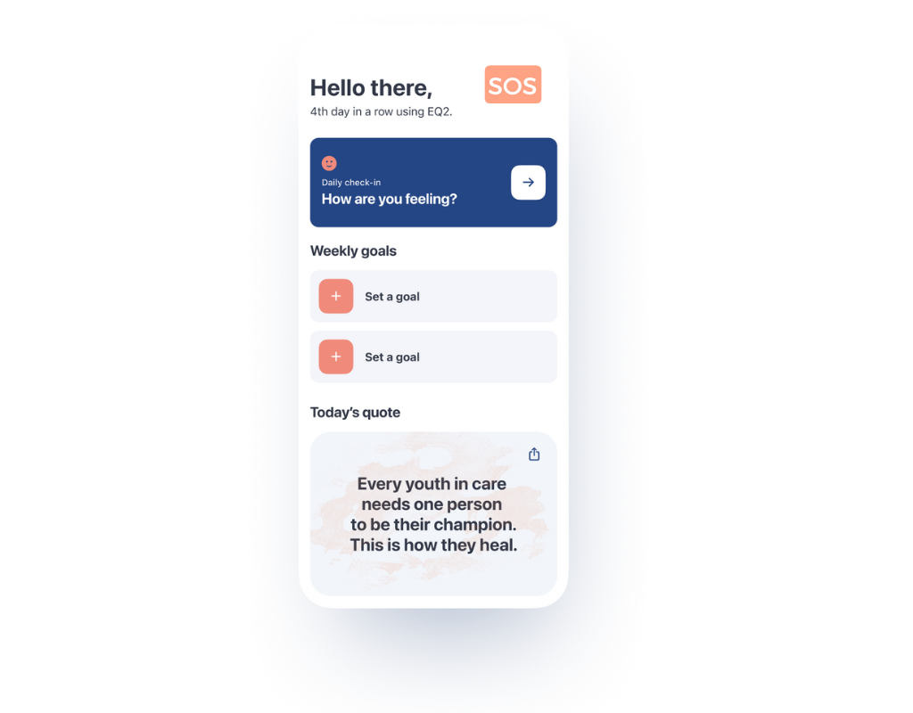

How Do We Do EQ2?
There are 6 EQ2 modules, which are completed in a group setting.
All EQ2 Participants Receive an EQ2 Handbook & EQ2 App Access.
Your personal workbook – take it to group and supervision, and write in it
Be heard and build a better community with restorative Circle practices
Use the guided visualizations and meditations
Watch the animated videos corresponding to each module
Set goals for the week and do a daily check-in
Use the SOS button for self-regulation in real time
You can use the App at work (if phones are permitted) and at home
Notes:
Read through slide. Share anything specific about how your agency has decided to roll out EQ2 or anything you’d like staff to know about implementation (e.g., when to expect groups to begin for them, what the expectations are for attendance). You might also highlight how EQ2 fits into other programs or material they are learning (e.g., around trauma-informed care, crisis de-escalation, etc.).
Encourage and remind staff that the App can be used OUTSIDE OF WORK! And that many people report using the skills at home with their own families and friends.

Slide 10

Take a Moment and Download the EQ2 App
Download the App by scanning the QR code or search for “EQ2: Staff Support” on the iOS App Store or Google Play
Click “Get Started” and sign in with your own email/password
When prompted for Agency Code, enter your facility’s code.
Notes:
Invite staff to download the app. Give them their specific facility code (or enter it on this slide). If you are doing this in a location where staff don’t have their phones, remind them where their App poster is (remember to hang these in a locker room or break room!).
If you would like, walk them through app components and invite staff to try it out as you talk through it:
When you first open the app, you’ll land on the home page, from here you can:
Check in (rate your ‘emotional weather’ as you start your shift, this helps us get accustomed to checking in with ourselves, and each other). Choose an intention for the day. You can check in every 24 hours or so
Check in or set your EQ2 goals for the week (resets every 7 days)
Read the daily quote and send it to people by using the small arrow at the top of the quote
Use the SOS button (located at the top of the home page) in moments you are feeling stressed. This is a guided breathing exercise that uses EQ2 Cool Thoughts to bring us back to baseline.
Under the “Practice” section, you’ll find all of the guided visualizations and meditations, ranging from 30 seconds to 12 minutes. There are also videos of grounding exercises. Most of these can be used alongside youth.
Under the “Learn” section, you’ll find all of the EQ2 videos. For each of the 6 EQ modules, there are 6-8 short videos (1-3 min each) of key EQ2 concepts, skills, and practices. As staff watch the videos, the ticker at the top will track their progress.
There are 4 videos in the “for youth” section that staff can show youth, which include discussion questions
EQ2+ includes booster content that staff can use to go deeper into EQ2 concepts. Each EQ2+ module also includes a short quiz.
Under the “More” section, staff can enable notifications, try the bell exercise, or get more resources for additional support (like crisis hotlines or low-cost therapy)

Slide 11

Restorative Circles in EQ2
Circles are one way EQ2 supports you as you do this important but challenging work.
“What’s one thing people might not know about you from looking at you?”
“What’s a personal strength you bring to this agency or your role?”
Notes:
Take about 15 minutes (depending on the size of your group) to introduce staff to Circles. You can say, “The EQ2 handbook is facilitated in something called a Circle, which is a way for everyone to get an opportunity to share what they think. Everyone gets a turn to speak, one at a time, with no cross talking. You can most certainly pass if you don’t want to speak.”
Sit staff (max 12 per circle) in a Circle with 1-2 facilitators. Go through one or both Circle prompts.
Share anything else you’d like for staff to know about how your facility/agency will use Circles (e.g., if you are already using them, describe).

